Slide 1
Timeframe
Intro 15 min
Agenda 5 min
Python 5 min
ML Python 20 min
OML4Python 10 min
Fashion MINST 30 min
Facial Expression Webapp 15 min
Summary / Q&A 15 min

Slide 3

Sascha Hagedorn
Master of Science (IT University of Copenhagen) – Digital Innovation and Management, Specialization: Data Science
Master Thesis – Deep Learning Model to analyse webshop clickstream data
Joined Oracle last year in august as part of the SE Hub
Oracle Code One – Hands On Lab

Slide 4
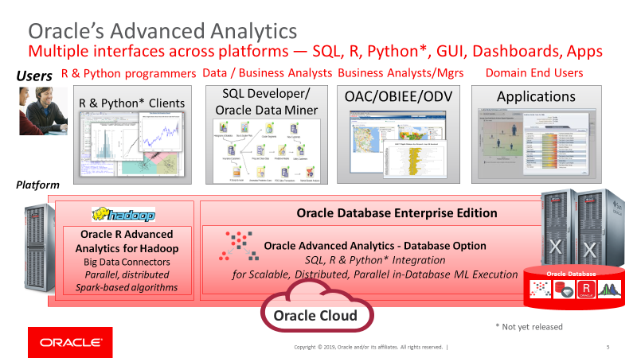
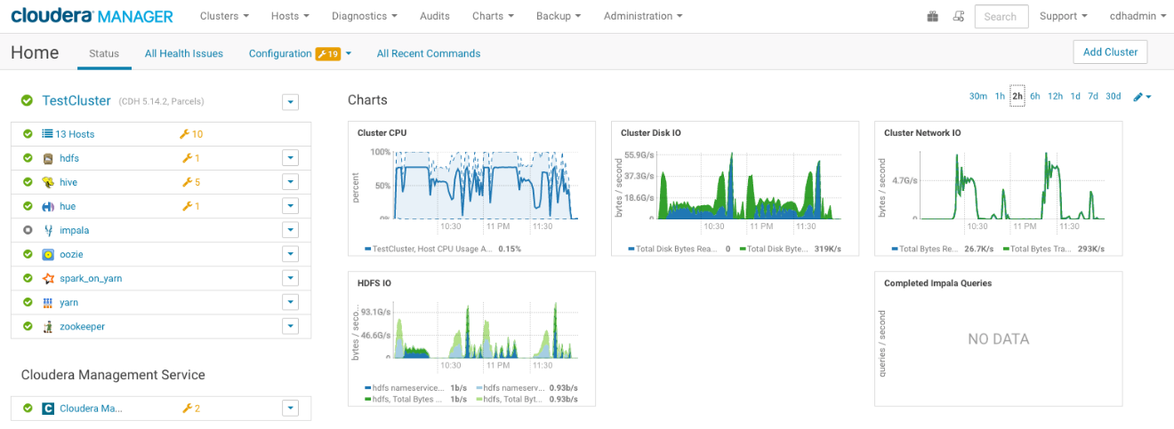
Focus
Machine Learning Solutions
ADW ML (PLSQL/OML4Py)
Python / R
Custom Images
Analytics Cloud
Data Flow
Big Data Service
Data Science Cloud
Data Flow
(Autonomous Data Warehouse)

Slide 5
Agenda
Python
Machine Learning in Python
OMl4Python Demo / Hands On
Fashion MINST Deep Learning
Facial Expression Web-App

Slide 7

Python

Slide 8

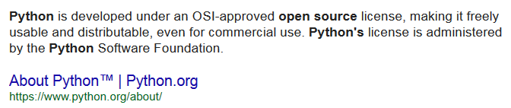
What is Python?
An interpreted, object-oriented, high level, general purpose programming language
Designed for rapid application development and scripting to connect existing components
Open source scripting language and environment https://www.python.org
Created in the late 1980s
World-wide usage
Widely taught in Universities
Many Data Scientists know and use Python
Thousands of open source packages to enhance productivity

Slide 9
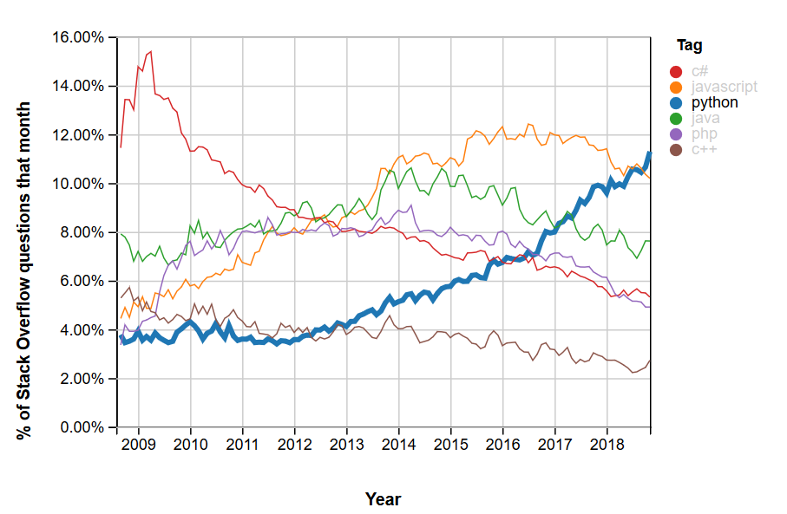
Popularity by question views for major PLs Growth of major programming languages using Stack Overflow question views
https://insights.stackoverflow.com/trends?tags=python%2Cjavascript%2Cjava%2Cc%23%2Cphp%2Cc%2B%2B&utm_source=so-owned&utm_medium=blog&utm_campaign=gen-blog&utm_content=blog-link&utm_term=incredible-growth-python

Slide 10
Why use Python?
Simple language
Wide-spread user groups
Small
Strict punctuation rules
Resembles English
Uniform code formatting
Many third-party libraries
Increasingly used by data scientists
Heavily used for websites
PyPI – 168203 projects
https://pypi.python.org/pypi

Slide 11

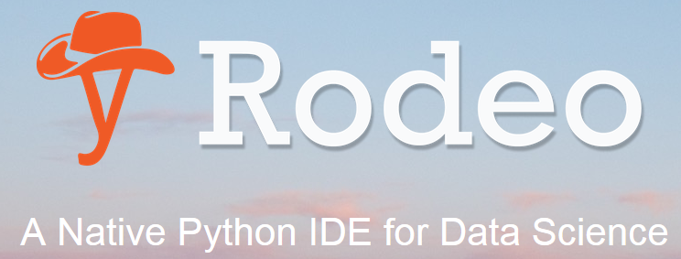
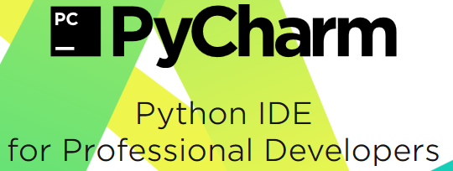
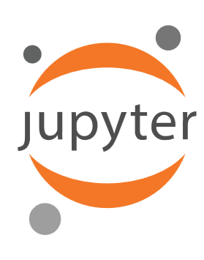
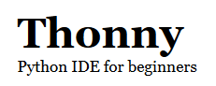

Python IDEs

Slide 12
Hands – On Machine Learning with Python

Slide 13

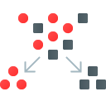
Oracle’s Machine Learning: Quick Overview
Move the Algorithms; Not the Data!
Notes:
Hello Everyone. Welcome to Oracle’s Think Autonomous Webcast Series.

Slide 14
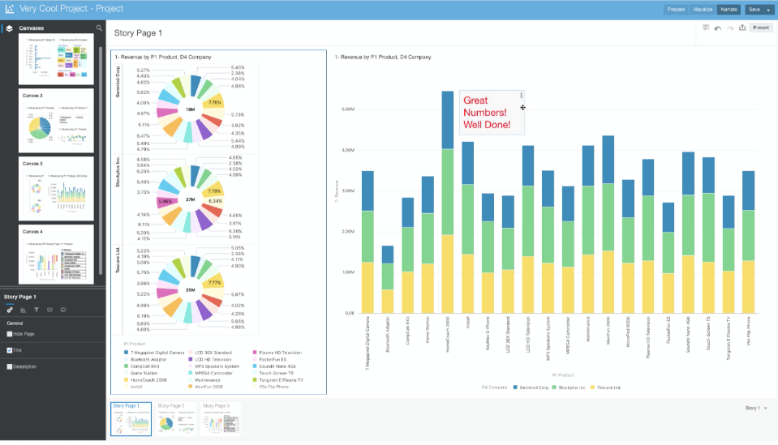
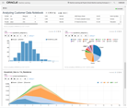
ADWC + Oracle Machine Learning Notebooks
Developer
Tools
Autonomous Data Warehouse Cloud
Analytics
Data Warehouse Services
(EDWs, DW, departmental marts and sandboxes)
Service Management
Built-in Access Tools
Oracle Business Analytics Cloud
Oracle Exadata Cloud Service
Oracle Database Cloud Service
Express Cloud Service
Oracle SQL Developer
Oracle Analytics Cloud
Service Console
Oracle Machine Learning
3rd Party Analytics on
Oracle Cloud Compute
Data Integration
Services
Oracle Data Integration Platform Cloud
3rd Party Analytics
On-premises
Autonomous Database Cloud
3rd Party DI on
Oracle Cloud Compute
Oracle Object Storage Cloud
Flat Files and Staging
3rd Party DI
On-premises

Slide 15

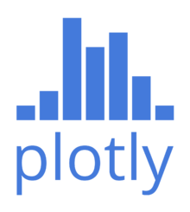

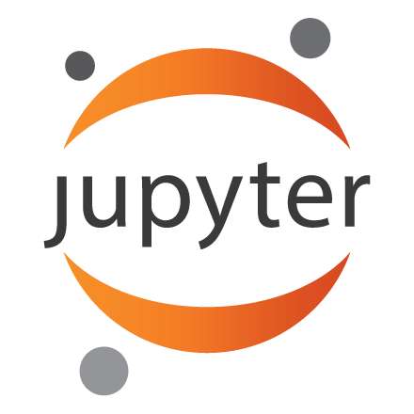

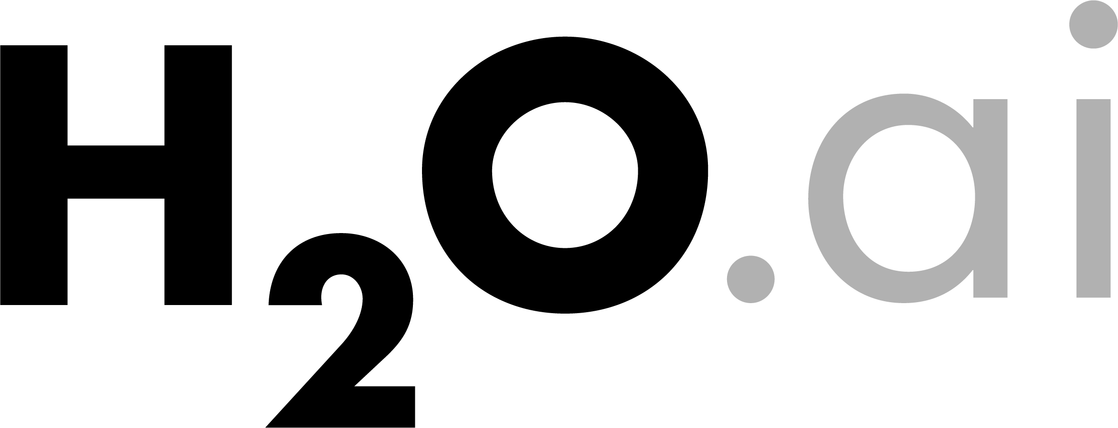
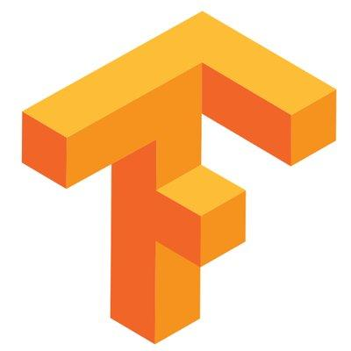
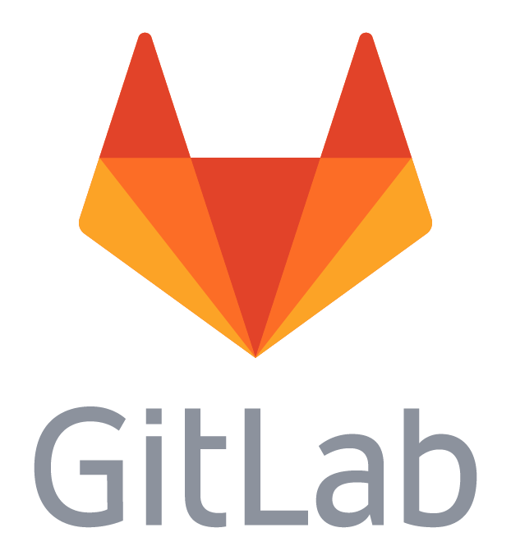




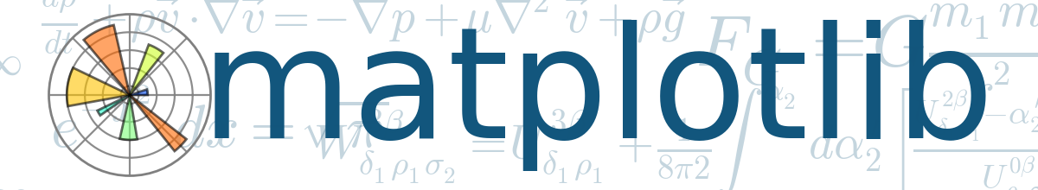

Oracle Data Science Cloud
Use the Best of Open Source
Platform supports a wide range of open source tools, libraries, and languages to tackle different use cases
Native support for most popular version control providers (Github, Gitlab, and Bitbucket) ensures all work is synced across the platform
Tight integration with OCI and Oracle Big Data Platform provides data scientists with self-service access to scalable compute and the data they need to get to work quickly
Tools & Languages
Visualization
Data Analysis, ML, AI
Version Control
Easily Access Data and Compute
Spark
Catalog
Data Warehouse
Streams
Batch
Object Store
Data Lake
NoSQL Databases
Self-Service Scalable Compute (OCI)

Slide 16
OML 4 Python

Slide 17
Oracle’s Python Technologies Supporting Oracle Database
cx_Oracle package
Oracle Machine Learning for Python Component of the Oracle Advanced Analytics option to Oracle Database

Slide 18
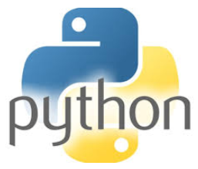
cx_Oracle
Python package enabling scalable and performant connectivity to Oracle Database
Open source, publicly available on PyPI, OTN, and github
Oracle is maintainer
Oracle Database Interface for Python conforming to Python DB API 2.0 specification
Optimized driver based on OCI
Execute SQL statements from Python
Enables transactional behavior for insert, update, and delete
Oracle Database
cx_Oracle

Slide 19
cx_Oracle Example
import cx_Oracle
con = cx_Oracle.connect('pythonhol/welcome@127.0.0.1/orcl')
print(con.version)
con.close()
con = cx_Oracle.connect('pythonhol', 'welcome', '127.0.0.1:/orcl:pooled',
cclass = "HOL", purity = cx_Oracle.ATTR_PURITY_SELF)
con.close()

Slide 20
cx_Oracle Example
cur = con.cursor() # opens cursor for statements to use
cur.execute('select * from departments order by department_id')
for result in cur: # prints all data
print(result)
#or
row = cur.fetchone() # return a single row as tuple and advance row
print(row)
row = cur.fetchone()
print(row)
#or
res = cur.fetchmany(numRows=3) # returns list of tuples
print(res)
cur.close()
con.close()

Slide 21
cx_Oracle - Requirements
Easily installed from PyPI
Support for Python 2 and 3
Support for Oracle Client 11.2, 12.1, 12.2, 18
Oracle's standard cross-version interoperability, allows easy upgrades and connectivity to different Oracle Database versions
Connect to Oracle Database 9.2, 10, 11, 12, 18
(Depending on the Oracle Client version used)
SQL and PL/SQL Execution
Underlying Oracle Client libraries have optimizations: compressed fetch, pre-fetching, client and server result set caching, and statement caching with auto-tuning

Slide 22
Data Types (1)
Full listing for cx_Oracle
cx_Oracle Type | Oracle Type | Python Type
cx_Oracle.BINARY | RAW | bytes (Python 3), str (Python 2)
cx_Oracle.BFILE | BFILE | cx_Oracle.LOB
cx_Oracle.BOOLEAN | boolean (PL/SQL only) | bool
cx_Oracle.CLOB | CLOB | cx_Oracle.LOB
cx_Oracle.CURSOR | REF CURSOR | cx_Oracle.Cursor
cx_Oracle.DATETIME | DATE | datetime.datetime
cx_Oracle.FIXED_CHAR | CHAR | str
cx_Oracle.FIXED_NCHAR | NCHAR | str (Python 3), unicode (Python 2)
cx_Oracle.INTERVAL | INTERVAL DAY TO SECOND | datetime.timedelta
cx_Oracle.LOB | CLOB, BLOB, BFILE, NCLOB | cx_Oracle.LOB
cx_Oracle.LONG_BINARY | LONG RAW | bytes (Python 3), str (Python 2)

Slide 23
Data Types (2)
Full listing for cx_Oracle
cx_Oracle Type | Oracle Type | Python Type
cx_Oracle.LONG_STRING | LONG | str
cx_Oracle.NATIVE_FLOAT | BINARY_DOUBLE | float
cx_Oracle.NATIVE_INT | - | int (Python 3), long/int (Python 2)
cx_Oracle.NCHAR | NVARCHAR2 | str (Python 3), unicode (Python 2)
cx_Oracle.NCLOB | NCLOB | cx_Oracle.LOB
cx_Oracle.NUMBER | NUMBER | float
cx_Oracle.OBJECT | instances created by CREATE OR REPLACE TYPE | cx_Oracle.Object
cx_Oracle.ROWID | ROWID | str
cx_Oracle.STRING | VARCHAR2 | str
cx_Oracle.TIMESTAMP | TIMESTAMP, TIMESTAMP WITH TIME ZONE, TIMESTAMP WITH LOCAL TIME ZONE | datetime.datetime

Slide 24
OML4Python

Slide 25
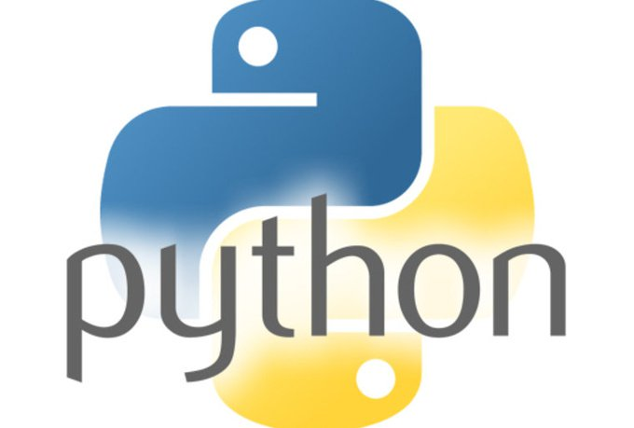
Traditional Python and Database Interaction
read
Flat Files
extract / export
Database
export
load
Cx_Oracle
OML4Python

Slide 26
Traditional Python and Database Interaction
read
Flat Files
extract / export
Database
export
load
SQL
mxODBC, pyodbc, turboodbc, JayDeBeApi, cx_Oracle
Access latency
Memory limitation – data size
Single threaded
Paradigm shift: Python → SQL → Python
Ad hoc production deployment
Issues for backup, recovery, security
Python script cron job

Slide 27


Oracle Machine Learning for Python Oracle Advanced Analytics option to Oracle Database >= 18c
Use Oracle Database as HPC environment
Use in-database parallel and distributed machine learning algorithms
Manage Python scripts and Python objects in Oracle Database
Integrate Python results into applications and dashboards via SQL
Produce better models faster with automated machine learning
SQL Interfaces
Python Client
SQL*Plus, SQLDeveloper, …
Oracle Machine Learning for Python
Oracle Database
Database
Server Machine
In-db stats
User tables

Slide 28
OML4Py 1.0
…plus open source Python packages for algorithms in combination with embedded Python execution
Machine Learning algorithms in-Database
Classification
Clustering
Market Basket Analysis
Decision Tree
Naïve Bayes
Generalized Linear Model
Support Vector Machine
RandomForest
Neural Network
Expectation Maximization
Hierarchical k-Means
Apriori – Association Rules
Attribute Importance
Feature Extraction
Minimum Description Length
Singular Value Decomposition
Explicit Semantic Analysis
Regression
Generalized Linear Model
Neural Network
Support Vector Machine
Anomaly Detection
1 Class Support Vector Machine
Supports integrated partitioned models, text mining
Notes:
28

Slide 29

Connect to the database
import oml
import os
sid = os.environ["ORACLE_SID"]
oml.connect(user="pyquser", password="pyquser",
dsn="(DESCRIPTION=(ADDRESS=(PROTOCOL=TCP)(HOST=...)
(PORT=1521))(CONNECT_DATA=(SID=sid)))")
oml.isconnected()
Python user on laptop
Client Python Engine
Transparency Layer
OML4Py
Oracle Database

Slide 30
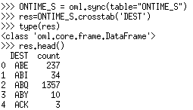
Invoke in-database aggregation function
ONTIME_S = oml.sync(table="ONTIME_S")
res = ONTIME_S.crosstab('DEST')
type(res)
res.head()
Python user on desktop
Source data is a DataFrame, ONTIME_S, which is an Oracle Database table
crosstab() function overloaded to accept OML DataFrame objects and transparently generates SQL for execution in Oracle Database
Returns an ‘oml.core.frame.DataFrame’ object
select DEST, count(*)
from ONTIME_S
group by DEST
Client Python Engine
Transparency Layer
OML4Py
Oracle Database
In-db stats
User tables

Slide 31
Oracle Machine Learning for Python
Transparency layer
Leverage proxy objects so data remain in database
Overload Python functions translating functionality to SQL
Use familiar Python syntax to manipulate database data
Parallel, distributed algorithms
Scalability and performance
Exposes in-database algorithms from Oracle Data Mining
Embedded Python execution
Manage and invoke Python scripts in Oracle Database
Data-parallel, task-parallel, and non-parallel execution
Use open source Python packages
Automated machine learning
Feature selection, model selection, hyper-parameter tuning
SQL Interfaces
Python Client
SQL*Plus, SQLDeveloper, …
Oracle Machine Learning for Python
Oracle Database
Database
Server Machine
In-db stats
User tables

Slide 32
OML4Py Transparency Layer
Leverages proxy objects for database data: oml.DataFrame
# Create table from Pandas DataFrame data DATA = oml.create(data, table = 'BOSTON')
# Get proxy object to DB table boston DATA = oml.sync(table = 'BOSTON')
Overloads Python functions translating functionality to SQL
Uses familiar Python syntax to manipulate database data
DATA.shape
DATA.head()
DATA.describe()
DATA.std()
DATA.skew()
train_dat, test_dat = DATA.split()
train_dat.shape
test_dat.shape

Slide 33
Data Transfer-related functions
oml.create(x, table[, oranumber, dbtypes, . . . ])
Creates a table in Oracle Database from a Pandas DataFrame returning a proxy object
oml.push(x[, oranumber, dbtypes])
Pushes data to Oracle Database creating a temporary table returning a proxy object
oml.sync(schema=None, regex_match=False, table=None, view=None, query=None)
Creates a DataFrame proxy object in Python that represents an Oracle Database table
oml.drop([table, view])
Drops the named database table or view
oml.dir()
Returns the names of OML objects in the workspace
oml.cursor()
Returns a cx_Oracle cursor object of the current OML database connection

Slide 34
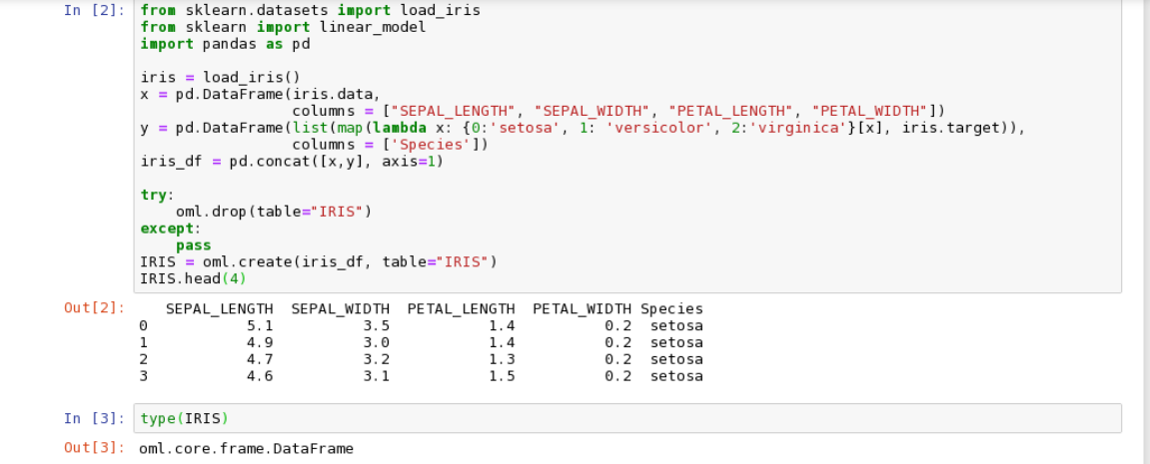

Slide 35
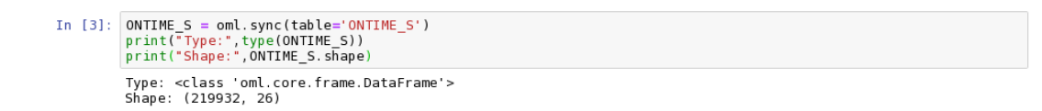

Slide 36
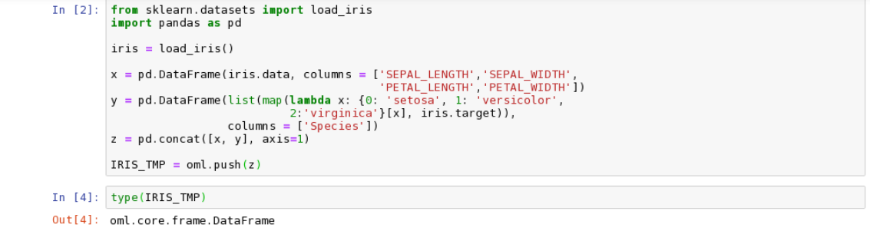

Slide 37
List of functions on OML DataFrame executed in-database
KFold
append
columns
concat
corr
count
create_view
crosstab
cumsum
describe
drop
drop_duplicates
dropna
head
kurtosis
materialize
max
mean
median
merge
min
nunique
pivot_table
pull
rename
round
select_types
shape
skew
sort_values
split
std
sum
t_dot
tail
types

Slide 38
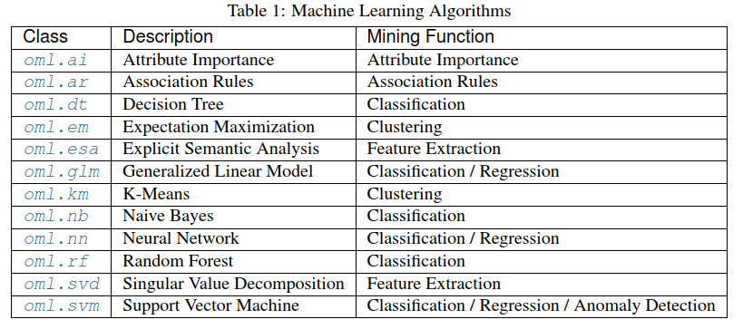
Table of OML4Python ML Algorithms

Slide 39
Embedded Python Execution functions
oml.do_eval(func[, func_value, func_owner, . . . ])
Executes the user-defined Python function at the Oracle Database server machine
oml.table_apply(data, func[, func_value, . . . ])
Executes the user-defined Python function at the Oracle Database server machine supplying data pulled from Oracle Database
oml.row_apply(data, func[, func_value, . . . ])
Partitions a table or view into row chunks and executes the user-defined python function on each chunk within one or more Python processes running at the Oracle Database server machine
oml.group_apply(data, index, func[, . . . ])
Partitions a table or view by the values in column(s) specified in index and executes the user-defined python function on those partitions within one or more Python processes running at the Oracle Database server machine
oml.index_apply(times, func[, func_value, . . . ])
Executes the user-defined python function multiple times inside Oracle Database server

Slide 40
OML4Py Embedded Python
def fit(data):
from sklearn.svm import LinearSVC x = data.drop('TARGET', axis = 1).values y = data['TARGET'] return LinearSVC().fit(x, y)
oml.script.create('sk_svc_fit', fit, overwrite = True)
oml.script.dir()
mod = oml.table_apply(train_dat, func = 'sk_svc_fit', oml_input_type = 'pandas.DataFrame')
Client Python Engine
1
OML4Py
2
Oracle Database
3
pyq*eval ()
interface
User tables
extproc
DB Python Engine
4
OML4Py

Slide 41
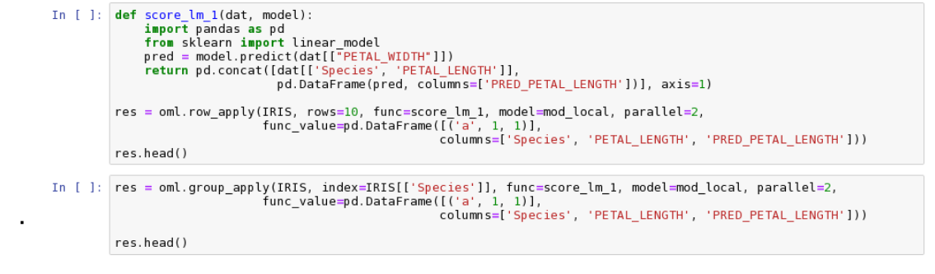

Slide 42
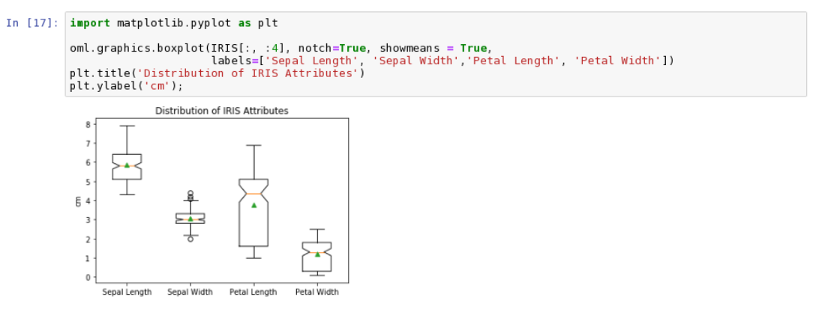

Slide 43
oml.group_apply – partitioned data flow
def build_lm(dat):
from sklearn import linear_model
lm = linear_model.LinearRegression()
X = dat[['PETAL_WIDTH']]
y = dat[['PETAL_LENGTH']]
lm.fit(X, y)
return lm
index = oml.DataFrame(IRIS['SPECIES'])
mods = oml.group_apply( IRIS[:,['PETAL_LENGTH',
"PETAL_WIDTH", 'SPECIES']], index, func=build_lm)
sorted(mods.pull().items())
Client Python Engine
1
OML4Py
2
Oracle Database
3
pyq*eval ()
interface
User tables
DB Python Engine
extproc
extproc
4
OML4Py
4
DB Python Engine
OML4Py

Slide 44
Script repository functions for saving Python scripts in ODB
oml.script.create(name, func[, is_global, . . . ])
Creates a Python script, which contains a single function definition, in the Oracle Database Python script repository
oml.script.dir([name, regex_match, sctype])
Lists the scripts present in the Oracle Database Python script repository
oml.script.load(name[, owner])
Loads the named script from the Oracle Database Python script repository as a callable object
oml.script.drop(name[, is_global, silent])
Drops the named script from the Oracle Database Python script repository
Notes:
to manage scripts

Slide 45
Datastore functions for saving Python objects in ODB
oml.ds.save(objs, name[, description, . . . ])
Saves Python objects to a datastore in the user’s Oracle Database schema
oml.ds.dir([name, regex_match, dstype])
Lists existing datastores available to the current session user
oml.ds.describe(name[, owner])
Describes the contents of the named datastore available to the current session user
oml.ds.load(name[, objs, owner, to_globals])
Loads Python objects from a datastore in the user’s Oracle Database schema
oml.ds.delete(name[, objs, regex_match])
Deletes one or more datastores from the user’s Oracle Database schema or deletes specific objects to delete from within a datastore
Notes:
manage access rights in python and database

Slide 46
Data Types
Mapping between OML4Py and Oracle Database
cx_Oracle Read | Python | cx_Oracle Write
varchar2, char, clob | str | varchar2, char, clob
number, binary_double, binary_float | float | if oranumber == True then number (default) else binary_double
 | boolean | if oranumber == True then number (default) else binary_double
raw, blob | bytes | raw, blob

Slide 47
AutoML – new with OML4Py in Oracle Advanced Analytics
Goal: increase model quality and data scientist productivity while reducing overall compute time
Auto Feature Selection
Reduce the number of features by identifying most relevant
Improve performance and accuracy
Auto Model Selection for classification and regression
Identify best algorithm to achieve maximum score
Find best model many times faster than with exhaustive search techniques
Auto Tuning of Hyper-parameters
Significantly improve model accuracy
Avoid manual or exhaustive search techniques

Slide 48
Auto Feature Selection: Motivation & Example
Many real-world datasets have a large number of irrelevant features
Slows down training
Goal: Speed-up ML pipeline by selecting most relevant features
33x
+4%
OpenML dataset 40996 (56000 rows, 784 columns)
Using SVM Gaussian with Auto Feature Selection
Features reduced from 784 to 309
Accuracy improves from 65.9% to 84.3%
Training time reduced 1.3x
OpenML dataset 312 with 1925 rows

Slide 49
Auto Feature Selection: Evaluation for OAA SVM Gaussian
150 Datasets with more than 500 cases
Avg Feature Reduction 52%
Avg Accuracy Gain 2.5%

Slide 50
Auto Feature Selection Example
fs = FeatureSelection(mining_function = 'classification',
score_metric = 'accuracy')
selected_features = fs.reduce('dt', X_train, y_train)
X_train = X_train[:,selected_features]

Slide 51
Auto Model Selection Example
ms = ModelSelection(mining_function = 'classification',
score_metric = 'accuracy')
best_model = ms.select(X_train, y_train)
y_pred = best_model.predict(X_test)

Slide 52
Auto Tune Example
at = Autotune(mining_function = 'classification',
score_metric = 'accuracy')
evals = at.tune('dt', X_train, y_train)
mod = evals['best_model']
y_pred = mod.predict(X_test)

Slide 53
Auto Tune: Evaluation for OAA Neural Network
.
Avg improvement of 2.86%
8-22% improvement for several datasets

Slide 54
Auto Tune: Evaluation for OAA Neural Network
.
Avg improvement of 1.68% across ~300 datasets
8-24% improvement for several datasets

Slide 55
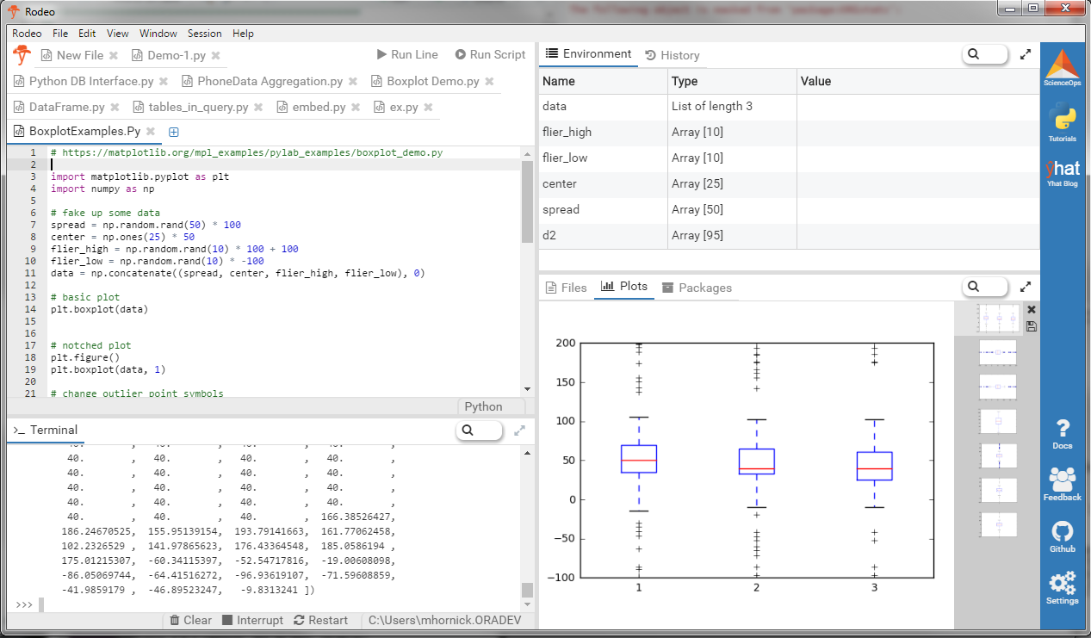

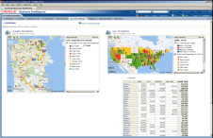
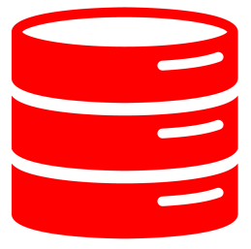

Web browser
OML4Py Client Python Engine
Zeppelin / Jupyter web interface
BDA / Hadoop
Web browser
Big Data SQL
Python Script Repository
Python Object Datastore
Oracle Database
Python 3 engine
OAA / OML4Py
Oracle Analytics Cloud Oracle Data Visualization Desktop OBIEE

Slide 56
Summary - Oracle Machine Learning for Python
Oracle Database enabled with Python scripting language and environment for the enterprise via Oracle Advanced Analytics option
Oracle’s Python technologies extend Python for enterprise use
Supports data analysis, exploration, and machine learning
Enables streamlined production development
Automates key data science steps for greater data scientist productivity, while enhancing accuracy and performance
Achieve performance and scalability leveraging Oracle Database as a high performance compute engine

Slide 57
Hands-On Fashion-MINST

Slide 58
Facial Expression
Webapp

Slide 59
Really hard to take AI into production.
Not just a case of building a model and deploying it
It involves worrying about
Data pipeline
Monitoring
Patching
Performance
Handling model drift
Worrying about bias
Interpretability
and much more…

Slide 60




Time Series
Exponential Smoothing
ARIMA
Classification
Decision Tree
Naïve Bayes
Generalized Linear Model
Support Vector Machine
Random Forest
Neural Network
Explicit Semantic Ana.
Market Basket Analysis
Apriori
Clustering
Expectation Maximization
Hierarchical k-Means
O-Cluster
Anomaly Detection
1 Class Support Vector Machine
Regression
Generalized Linear Model
Support Vector Machine
Neural Network
Linear Regression
Decision Tree
Attribute Importance
Minimum Description Length
CUR matrix decomposition
Feature Extraction
Explicit Semantic Analysis
Non-Negative Matrix Factorization
Singular Value Decomposition
Principal Component Analysis
MLlib / ORAAH
ODM SQL API
OAC
Oracle R Enterprise
OML4py

